Slide 1
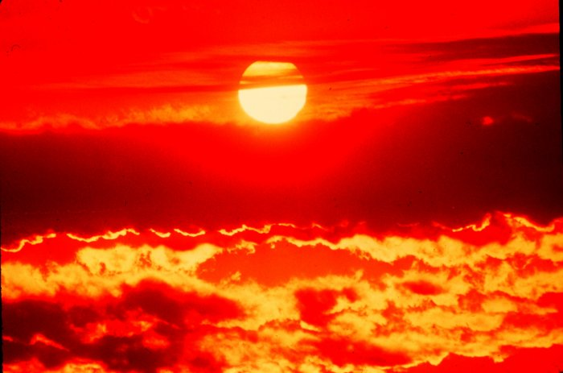
Once upon a time, there was no rain on the earth and all the animals were thirsty.

Slide 2
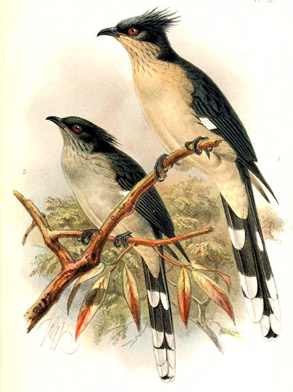
There was a bird named Babiha. Babiha was were thirsty too. He did not drink any water from the river or pool.He drank only rain water drop-by-drop. So he called Guru sahib and shouted
"CHOO- CHOO CHOO-CHOO! GURU SAHIB PANI DO!" But there was no rain!

Slide 3
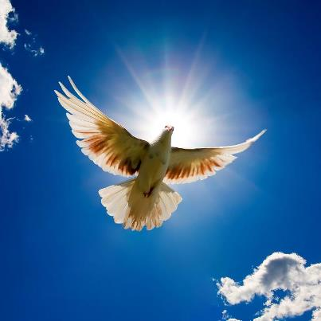
Babiha searched guru sahib flying high in the sky, but he did not find Guru Sahib anywhere.

Slide 4

Babiha searched the whole world, but Guru sahib was no where to be seen.

Slide 5

Babiha wrote on a letter "CHOO- CHOO CHOO-CHOO! GURU SAHIB PANI DO!"
But there was no rain

Slide 6
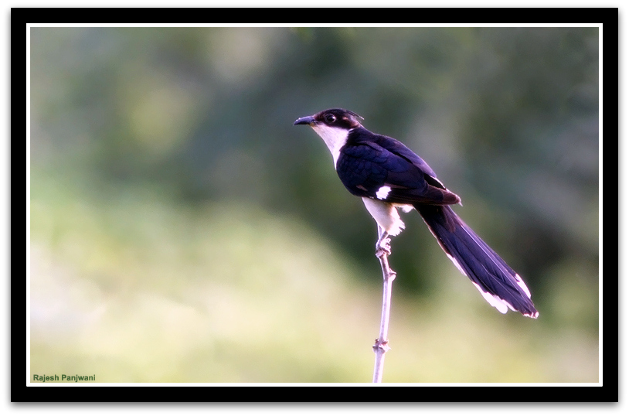
Babiha got up amritvele and started doing simran and ardas.
bwbIhw AMimRq vylY boilAw
baabeehaa a(n)mrith vaelai boliaa

Slide 7
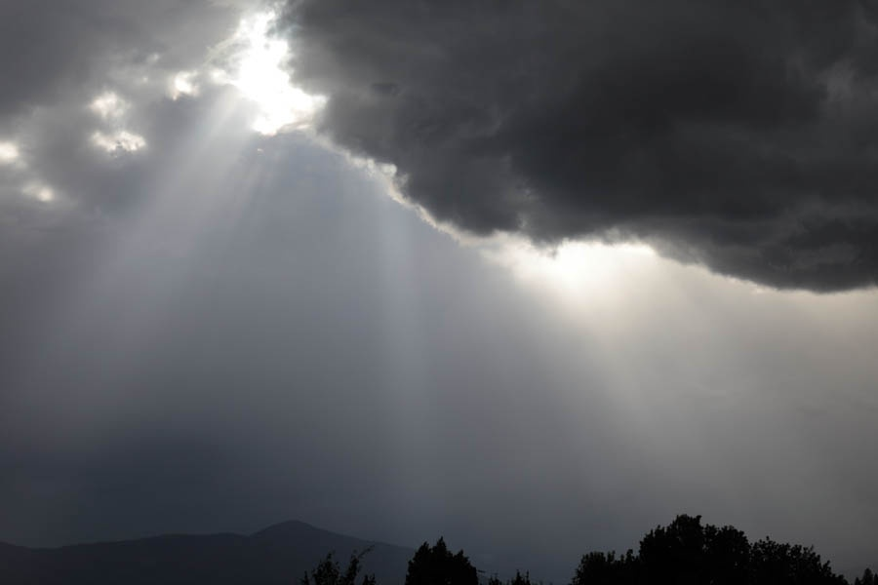
Guru sahib heard his crying and ordered the clouds
qW dir suxI pukwr ]
myGY no Purmwnu hoAw
thaa(n) dhar sunee pukaar ||
maeghai no furamaan hoaa

Slide 8
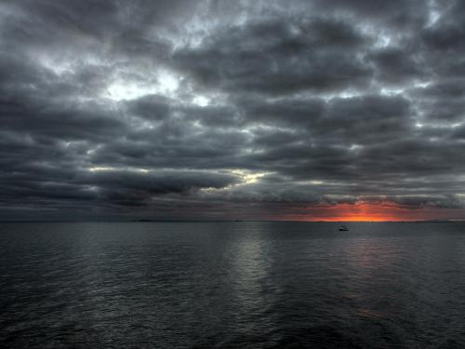
What did he order to the clouds?
Dhoom-Dhaam Dhoom-Dhaam Rain started pouring down.
vrshu ikrpw Dwir ]
varasahu kirapaa dhhaar ||

Slide 9
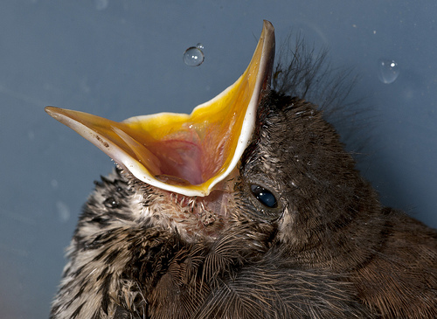
Babiha drank the rain water drop-by-drop.

Slide 10

Guru sahib said "I love those who remember Vaheguru in their hearts"
hau iqn kY bilhwrxY ijnI scu riKAw auir Dwir ]
ho thin kai balihaaranai jinee sach rakhiaa our dhhaar ||

Slide 11
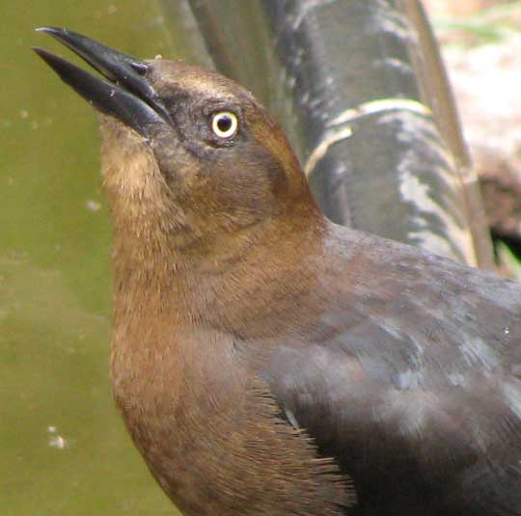
He said to Guru Sahib "Thank you"

Slide 12
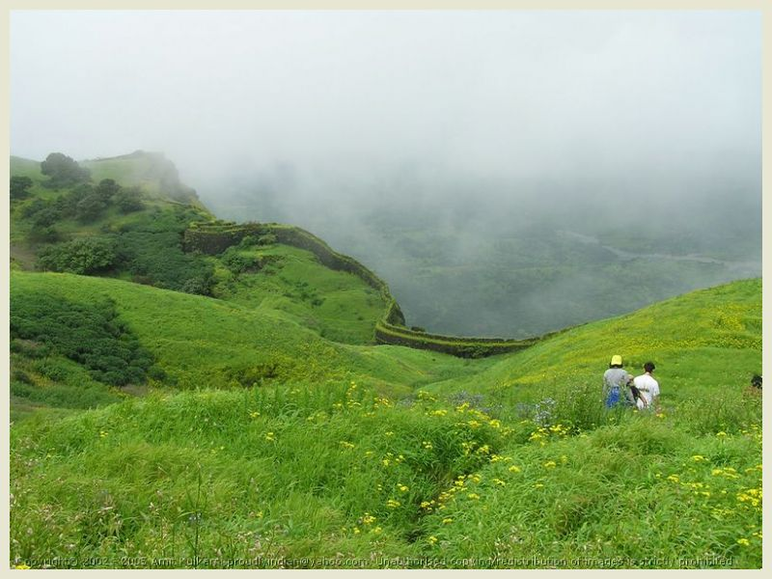
Guru Sahib said "There will always be happiness if you remember vaheguru all the time"
nwnk nwmy sB hrIAwvlI gur kY sbid vIcwir ]1]
naanak naamae sabh hareeaavalee gur kai sabadh veechaar ||1||

